Slide 1

Raising and Lower Indexes
$$T^{i}↔T_{i}$$

Slide 2


Warning: Video contains
non-standard tensor product notation
$$\vec{e_{i}}ε^{j}$$
$$\vec{e_{i}}⊗ε^{j}$$

Slide 3
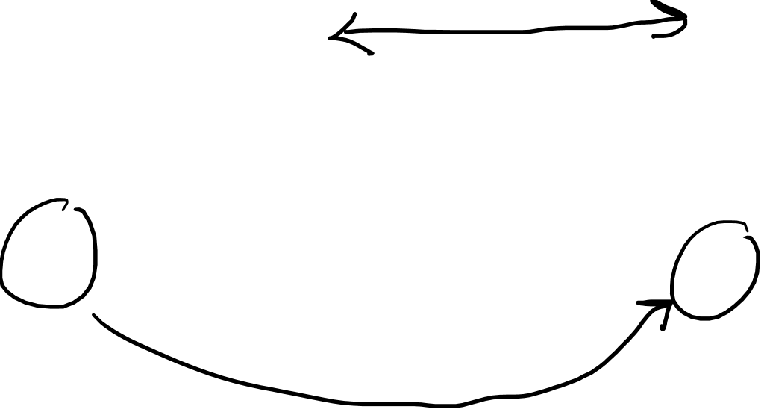
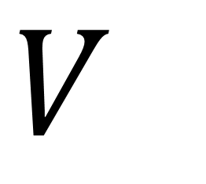

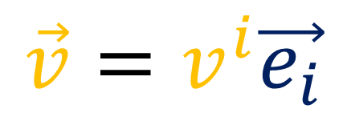
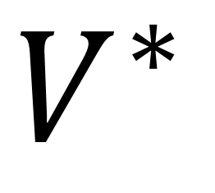
$$V$$
$$V^{∗}$$
$$\vec{v}=v^{i}\vec{e_{i}}$$
$$α=α_{j}ε^{j}$$

Slide 4


$$V$$
$$V^{∗}$$
$$\vec{e_{i}}$$
$$ε^{i}$$

Slide 5

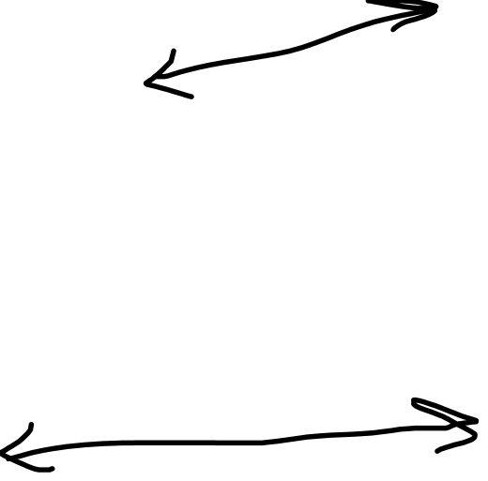

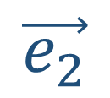
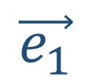
$$ε^{1}$$
$$\vec{e_{1}}$$
$$\vec{e_{2}}$$
$$ε^{2}$$

Slide 6
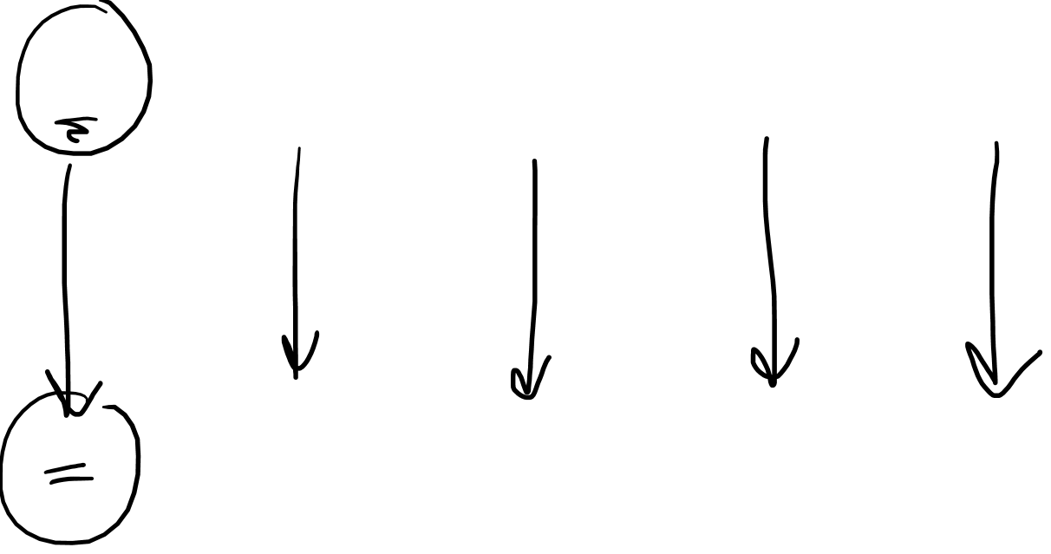
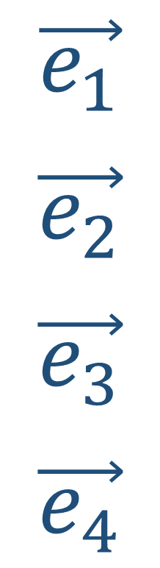
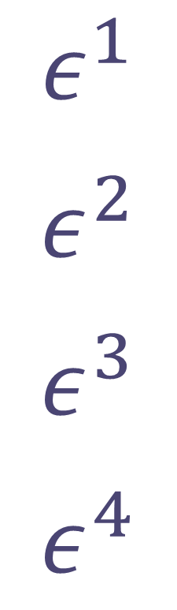
$$\vec{e_{1}}$$
$$\vec{e_{2}}$$
$$\vec{e_{3}}$$
$$\vec{e_{4}}$$
$$ε^{1}$$
$$ε^{2}$$
$$ε^{3}$$
$$ε^{4}$$
$$\vec{v}=v^{1}\vec{e_{1}}+v^{2}\vec{e_{2}}+v^{3}\vec{e_{3}}+v^{4}\vec{e_{4}}$$
$$α=v^{1}ε^{1}+v^{2}ε^{2}+v^{3}ε^{3}+v^{4}ε^{4}$$

Slide 7
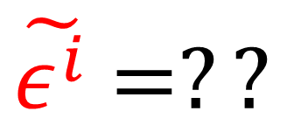
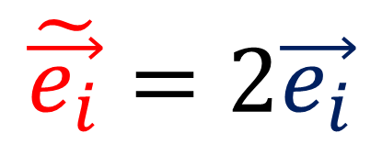


$$V$$
$$V^{∗}$$
$$\vec{e_{i}}$$
$$ε^{i}$$
$$\tilde{\vec{e_{i}}}=2\vec{e_{i}}$$
$\tilde{ε^{i}}$ $=??$

Slide 8
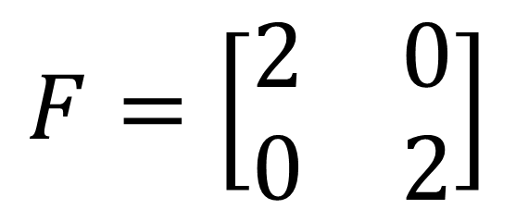
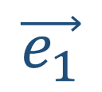
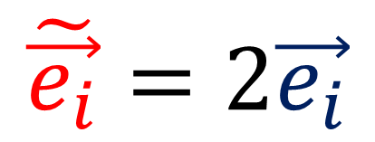
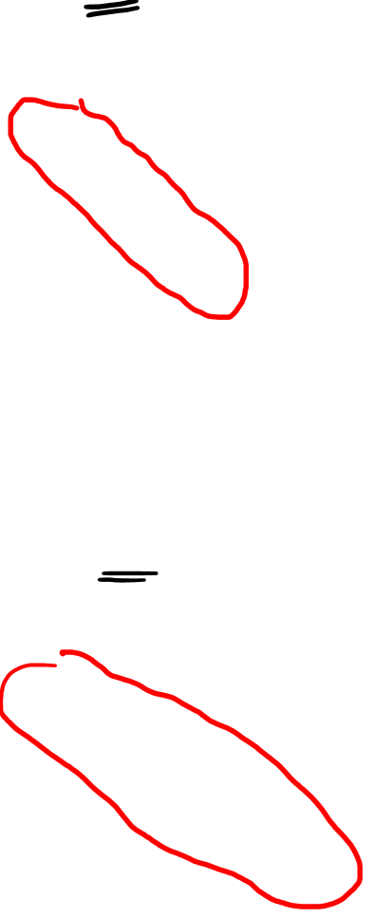
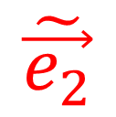
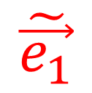
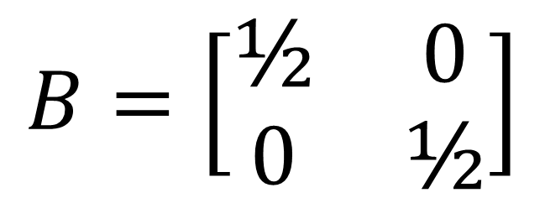

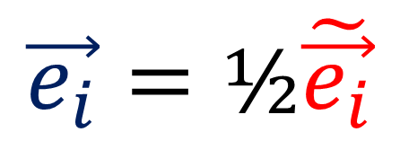
$$\tilde{\vec{e_{i}}}=2\vec{e_{i}}$$
$$\tilde{\vec{e_{2}}}$$
$$F=\left[\begin{matrix}2 & 0 \\ 0 & 2\end{matrix}\right]$$
$$\vec{e_{2}}$$
$$\vec{e_{i}}=\text{½}\tilde{\vec{e_{i}}}$$
$$\vec{e_{1}}$$
$$\tilde{\vec{e_{1}}}$$
$$B=\left[\begin{matrix}\text{½} & 0 \\ 0 & \text{½}\end{matrix}\right]$$

Slide 9
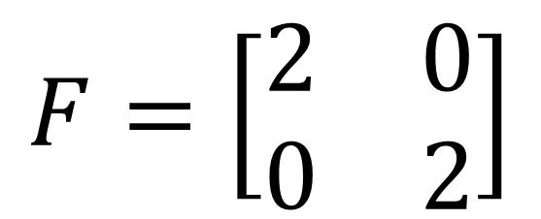
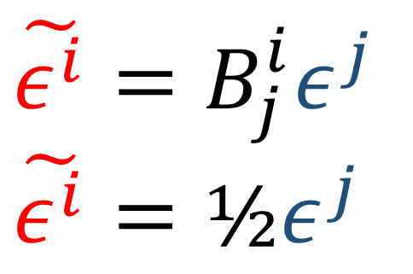
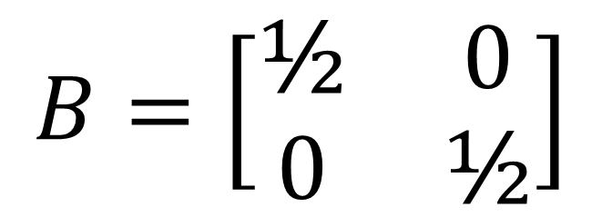
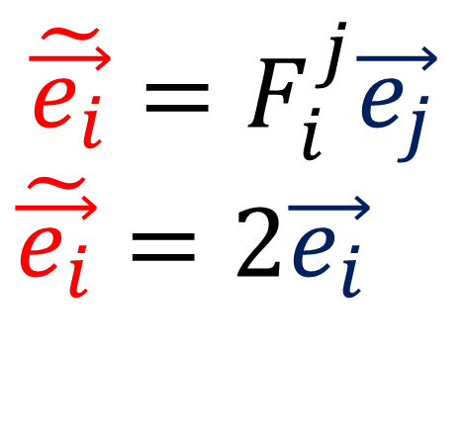
$$\tilde{\vec{e_{i}}}=F_{i}^{j}\vec{e_{j}}$$
$$\tilde{\vec{e_{i}}}=2\vec{e_{i}}$$
$$F=\left[\begin{matrix}2 & 0 \\ 0 & 2\end{matrix}\right]$$
$$\tilde{ε^{i}}=B_{j}^{i}ε^{j}$$
$$\tilde{ε^{i}}=\text{½}ε^{j}$$
$$B=\left[\begin{matrix}\text{½} & 0 \\ 0 & \text{½}\end{matrix}\right]$$

Slide 10
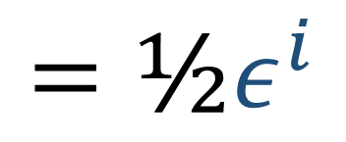
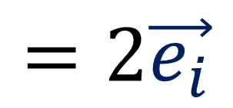
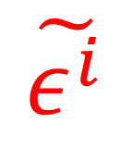
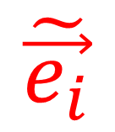
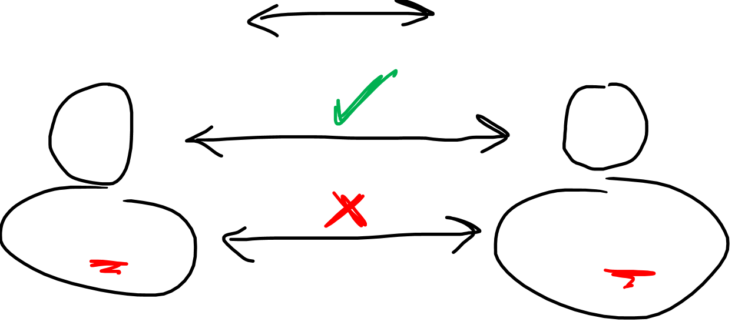
$$V$$
$$V^{∗}$$
$$\tilde{\vec{e_{i}}}$$
$$\tilde{ε^{i}}$$
$$=2\vec{e_{i}}$$
$$=\text{½}ε^{i}$$

Slide 11
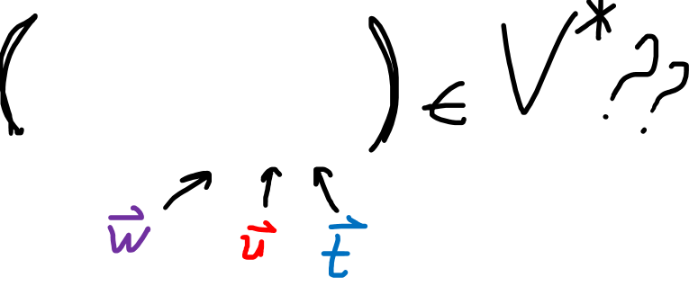
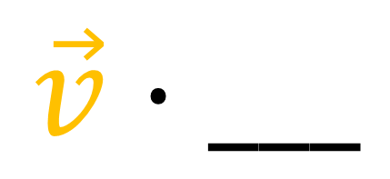

$$V$$
$$V^{∗}$$
$$\vec{v}⋅___$$
$$\vec{v}$$

Slide 12
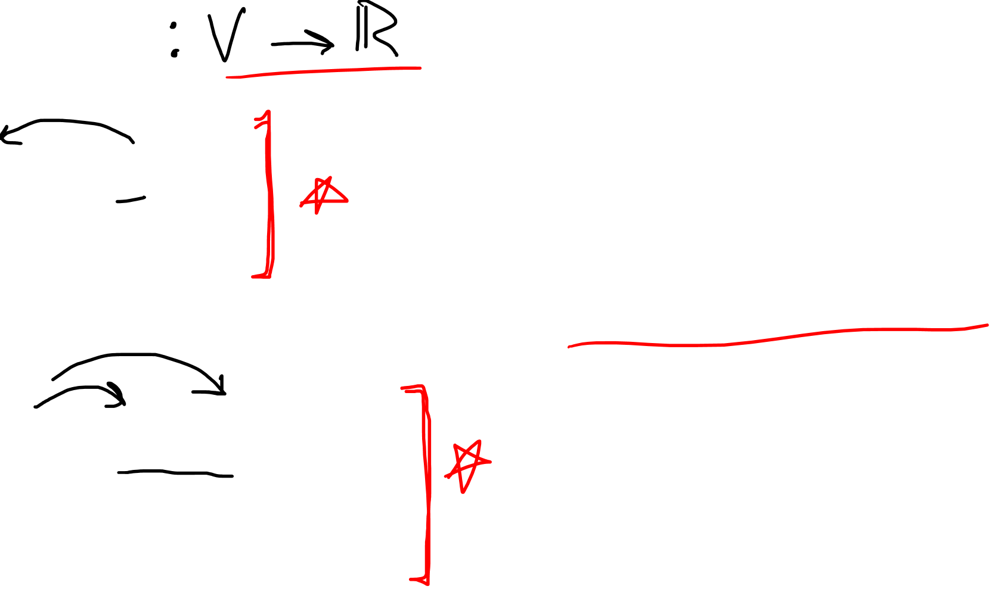
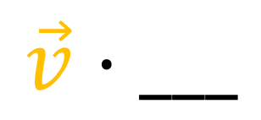
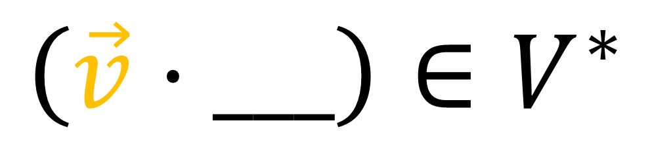
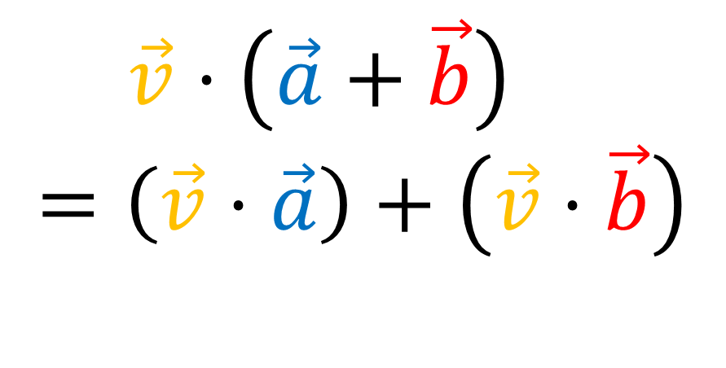
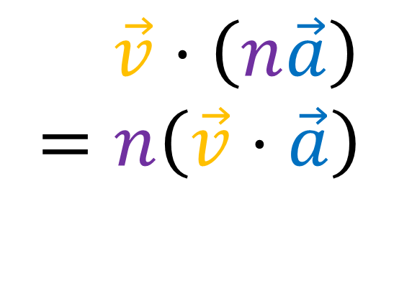
$$\vec{v}⋅___$$
$\vec{v}⋅\left(n\vec{a}\right)$
$$=n\left(\vec{v}⋅\vec{a}\right)$$
$$\left(\vec{v}⋅___\right)∈V^{∗}$$
$\vec{v}⋅\left(\vec{a}+\vec{b}\right)$
$$=\left(\vec{v}⋅\vec{a}\right)+\left(\vec{v}⋅\vec{b}\right)$$

Slide 13
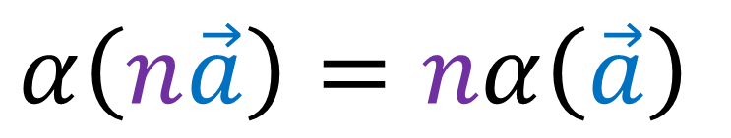



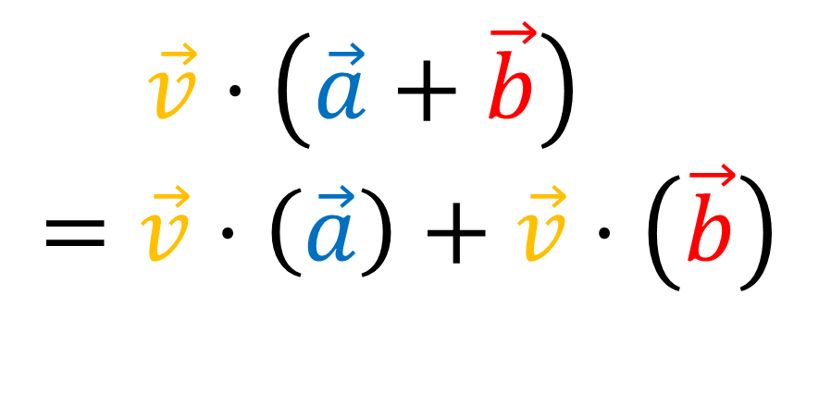
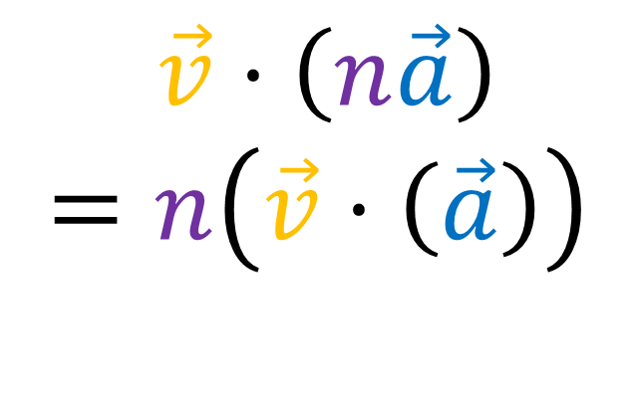
$$α:V→ℝ$$
$$\vec{v}⋅___ :V→ℝ$$
$$α\left(n\vec{a}\right)=nα\left(\vec{a}\right)$$
$\vec{v}⋅\left(n\vec{a}\right)$
$$=n\left(\vec{v}⋅\left(\vec{a}\right)\right)$$
$$α\left(\vec{a}+\vec{b}\right)=α\left(\vec{a}\right)+α\left(\vec{b}\right)$$
$\vec{v}⋅\left(\vec{a}+\vec{b}\right)$
$$=\vec{v}⋅\left(\vec{a}\right)+\vec{v}⋅\left(\vec{b}\right)$$

Slide 14
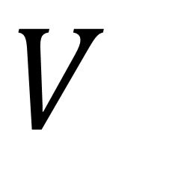
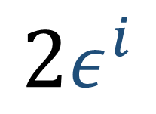
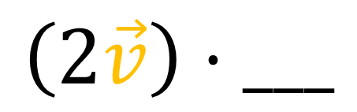
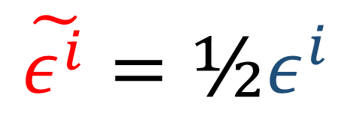
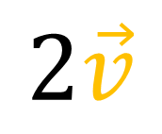
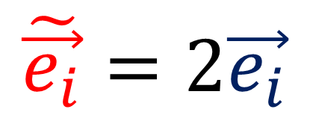

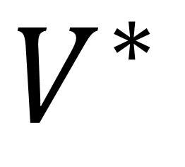

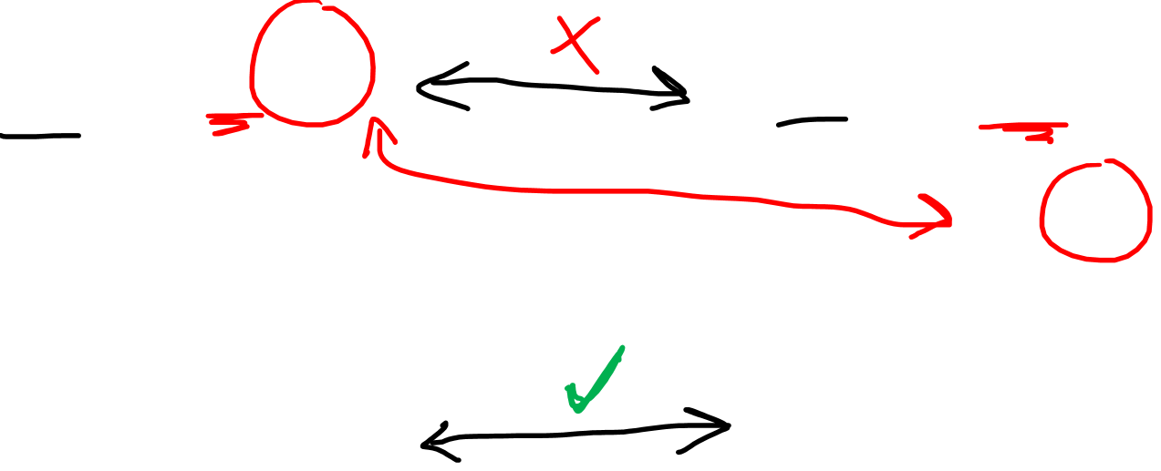
$$V$$
$$V^{∗}$$
$$\tilde{\vec{e_{i}}}=2\vec{e_{i}}$$
$$\tilde{ε^{i}}=\text{½}ε^{i}$$
$$\text{2}ε^{i}$$
$$\vec{v}$$
$$\vec{v}⋅___$$
$$2\vec{v}$$
$$\left(2\vec{v}\right)⋅___$$

Slide 15

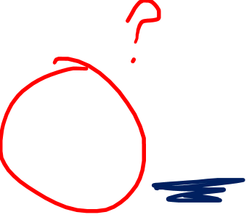
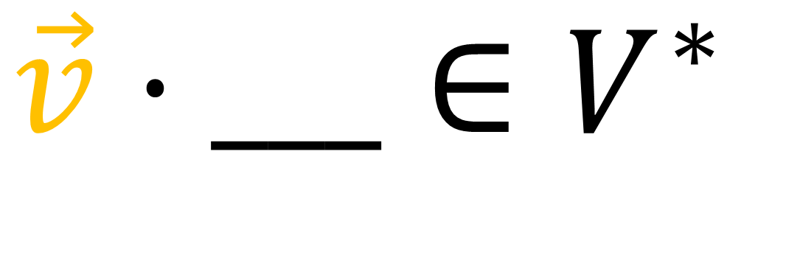
$${\vec{v}⋅___∈V}^{∗}$$
$$\vec{v}⋅___=x_{i}ε^{i}$$

Slide 16

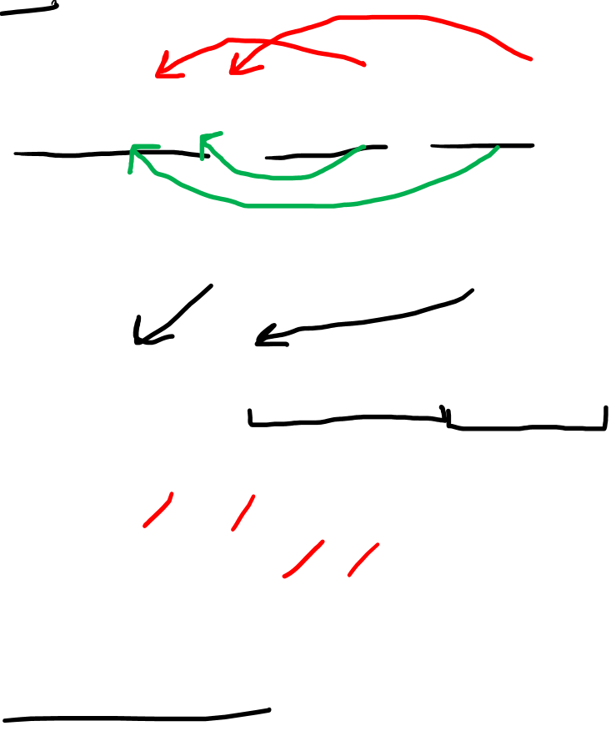


$$\vec{v}⋅\vec{w}=g\left(\vec{v},\vec{w}\right)$$
$$g\left(\vec{v},\vec{w}\right)=g\left(\vec{w},\vec{v}\right)$$
$$=g_{ij}ε^{i}ε^{j}\left(v^{k}\vec{e_{k}},w^{l}\vec{e_{l}}\right)$$
$$=g_{ij}ε^{i}\left(v^{k}\vec{e_{k}}\right)ε^{j}\left(w^{l}\vec{e_{l}}\right)$$
$$=g_{ij}v^{k}w^{l}ε^{i}\left(\vec{e_{k}}\right)ε^{j}\left(\vec{e_{l}}\right)$$
$$=g_{ij}v^{k}w^{l}δ_{k}^{i}δ_{l}^{j}$$
$$=g_{ij}v^{i}w^{j}$$

Slide 17

$$\vec{v}⋅\vec{w}=g\left(\vec{v},\vec{w}\right)=g_{ij}v^{i}w^{j} =\tilde{g_{ij}}\tilde{v^{i}}\tilde{w^{j}}$$
$$\vec{v}⋅__=g\left(\vec{v},__\right)=g_{ik}ε^{i}ε^{k}\left(v^{j}\vec{e_{j}}\right)=\tilde{g_{ik}}\tilde{ε^{i}}\tilde{ε^{k}}\left(\tilde{v^{j}}\tilde{\vec{e_{j}}}\right)$$
$$\vec{v}⋅__=g\left(\vec{v},__\right)=g_{ik}v^{j}ε^{i}ε^{k}\left(\vec{e_{j}}\right)=\tilde{g_{ik}}\tilde{v^{j}}\tilde{ε^{i}}\tilde{ε^{k}}\left(\tilde{\vec{e_{j}}}\right)$$
$$\vec{v}⋅__=g\left(\vec{v},__\right)=g_{ik}v^{j}ε^{i}δ_{j}^{k} =\tilde{g_{ik}}\tilde{v^{j}}\tilde{ε^{i}}δ_{j}^{k}$$
$$\vec{v}⋅__=g\left(\vec{v},__\right)=g_{ij}v^{j}ε^{i} =\tilde{g_{ij}}\tilde{v^{j}}\tilde{ε^{i}}$$

Slide 18






$$\vec{v}⋅__=g\left(\vec{v},__\right)=g_{ij}v^{j}ε^{i} =\tilde{g_{ij}}\tilde{v^{j}}\tilde{ε^{i}}$$
$$\vec{v}⋅__=g\left(\vec{v},__\right)= v_{i}ε^{i} = \tilde{v_{i}}\tilde{ε^{i}}$$
$$g_{ij}v^{j}=v_{i}$$
$$\tilde{g_{ij}}\tilde{v^{j}}=\tilde{v_{i}}$$
$$\vec{v}=v^{j}\vec{e_{j}}$$
$$\vec{v}⋅__=v_{i}ε^{i}$$

Slide 19




$$\vec{v} =v^{j}\vec{e_{j}}=\tilde{v^{j}}\tilde{\vec{e_{j}}}$$
$$\vec{v}⋅__=v_{i}ε^{i}=\tilde{v_{i}}\tilde{ε^{i}}$$
$$\tilde{v_{i}}=\tilde{g_{ij}}\tilde{v^{j}}$$
$$v_{i}=g_{ij}v^{j}$$

Slide 20




$$v_{i}≠v^{i}$$
$$v_{i}=g_{ij}v^{j}$$
(Unless $g_{ij}=δ_{ij}$)
(orthonormal coordinate system)

Slide 21






Metric Tensor
$$V$$
$$g$$
$$V^{∗}$$
$$\vec{v}$$
$$\vec{v}⋅___$$

Slide 22









$$\vec{v} =v^{j}\vec{e_{j}}=\tilde{v^{j}}\tilde{\vec{e_{j}}}$$
$$\vec{v}⋅__=v_{i}ε^{i}=\tilde{v_{i}}\tilde{ε^{i}}$$
Metric Tensor
$$g∈V^{∗}⊗V^{∗}$$
“Inverse” Metric Tensor
$$𝔤∈V⊗V$$
$$v_{i}=g_{ij}v^{j}$$
$$\tilde{v_{i}}=\tilde{g_{ij}}\tilde{v^{j}}$$
$$𝔤^{ki}g_{ij}=δ_{j}^{k}=\tilde{𝔤^{ki}}\tilde{g_{ij}}$$
$$\tilde{v_{i}}=\tilde{g_{ij}}\tilde{v^{j}}$$
$$\tilde{𝔤^{ki}}\tilde{v_{i}}=\tilde{𝔤^{ki}}\tilde{g_{ij}}\tilde{v^{j}}$$
$$\tilde{𝔤^{ki}}\tilde{v_{i}}=δ_{j}^{k}\tilde{v^{j}}$$
$$\tilde{𝔤^{ki}}\tilde{v_{i}}=\tilde{v^{k}}$$
$$v_{i}=g_{ij}v^{j}$$
$$𝔤^{ki}v_{i}=𝔤^{ki}g_{ij}v^{j}$$
$$𝔤^{ki}v_{i}=δ_{j}^{k}v^{j}$$
$$𝔤^{ki}v_{i}=v^{k}$$

Slide 23

$$\vec{v} =v^{j}\vec{e_{j}}=\tilde{v^{j}}\tilde{\vec{e_{j}}}$$
$$\vec{v}⋅__=v_{i}ε^{i}=\tilde{v_{i}}\tilde{ε^{i}}$$
Metric Tensor
$$g∈V^{∗}⊗V^{∗}$$
“Inverse” Metric Tensor
$$𝔤∈V⊗V$$
$$v_{i}=g_{ij}v^{j}$$
$$\tilde{v_{i}}=\tilde{g_{ij}}\tilde{v^{j}}$$
$$𝔤^{ki}g_{ij}=δ_{j}^{k}=\tilde{𝔤^{ki}}\tilde{g_{ij}}$$
$$\tilde{v_{i}}=\tilde{g_{ij}}\tilde{v^{j}}$$
$$\tilde{𝔤^{ki}}\tilde{v_{i}}=\tilde{𝔤^{ki}}\tilde{g_{ij}}\tilde{v^{j}}$$
$$\tilde{𝔤^{ki}}\tilde{v_{i}}=δ_{j}^{k}\tilde{v^{j}}$$
$$\tilde{𝔤^{ki}}\tilde{v_{i}}=\tilde{v^{k}}$$
$$v_{i}=g_{ij}v^{j}$$
$$𝔤^{ki}v_{i}=𝔤^{ki}g_{ij}v^{j}$$
$$𝔤^{ki}v_{i}=δ_{j}^{k}v^{j}$$
$$𝔤^{ki}v_{i}=v^{k}$$

Slide 24


Metric Tensor
(covariant metric tensor)
$$V$$
$$g$$
$$V^{∗}$$
$$𝔤$$
$$\vec{v}$$
$$\vec{v}⋅___$$
Inverse Metric Tensor
(contravariant metric tensor)

Slide 25




$$\vec{v} =v^{j}\vec{e_{j}}=\tilde{v^{j}}\tilde{\vec{e_{j}}}$$
$$\vec{v}⋅__=v_{i}ε^{i}=\tilde{v_{i}}\tilde{ε^{i}}$$
$$𝔤^{ki}g_{ij}=δ_{j}^{k}=\tilde{𝔤^{ki}}\tilde{g_{ij}}$$
$$v_{i}=g_{ij}v^{j}$$
$$v^{i}=𝔤^{ij}v_{j}$$
$$\tilde{v_{i}}=\tilde{g_{ij}}\tilde{v^{j}}$$
$$\tilde{v^{i}}=\tilde{𝔤^{ij}}\tilde{v_{j}}$$

Slide 26







$$Q∈V⊗V^{∗}⊗V^{∗}$$
$$Q=Q_{jk}^{i}\vec{e_{i}}ε^{j}ε^{k}$$
$$D∈V⊗V$$
$$D=D^{ab}\vec{e_{a}}\vec{e_{b}}$$
$$Q_{ jk}^{i}𝔤^{jx}$$
$${=Q}_{ k}^{ix}$$
$$D^{ab}g_{ax}$$
$$=D_{x}^{ b}$$
$$Q^{′}{=Q}_{ k}^{ix}\vec{e_{i}}\vec{e_{x}}ε^{k}$$
$$Q^{′}∈V⊗V⊗V^{∗}$$
$$D′=D_{x}^{ b}ε^{x}\vec{e_{b}}$$
$$D^{′}∈V^{∗}⊗V$$

Slide 27



















$$V⊗V⊗V$$
$$T^{ijk}$$
$$𝔤$$
$$V^{∗}⊗V⊗V$$
$$V⊗V^{∗}⊗V$$
$$V⊗V⊗V^{∗}$$
$$T_{i}^{ jk}$$
$$T_{ j}^{i k}$$
$$T_{ k}^{ij }$$
$$V^{∗}⊗V^{∗}⊗V$$
$$V^{∗}⊗V⊗V^{∗}$$
$$V⊗V^{∗}⊗V^{∗}$$
$$g$$
$$T_{ij}^{ k}$$
$$T_{ i k}^{ j }$$
$$T_{ jk}^{i }$$
$$V^{∗}⊗V^{∗}⊗V^{∗}$$
$$T_{ijk}$$

Slide 28













$$\vec{v}=v^{i}\vec{e_{i}}$$
$$\text{♭}\vec{v}=v_{i}ε^{i}$$
$\vec{v}⋅__$ $=g\left(\vec{v},__\right)$
$$=\text{♭}\vec{v}$$
$$\text{♭}$$
$$\vec{v}$$
$$\vec{v}⋅__$$
$$α=\vec{a}⋅__$$
$=𝔤\left(α,__\right)$
$$α=α_{i}ε^{i}$$
$$\text{♯}α=α^{i}\vec{e_{i}}$$
$$\text{♯}$$
$$\vec{a}$$
$$\text{♯}α↦\vec{a}$$
$$α$$

Slide 29

$$\vec{v}=v^{i}\vec{e_{i}}$$
$$\text{♭}\vec{v}=v_{i}ε^{i}$$
$\vec{v}⋅__$ $=g\left(\vec{v},__\right)$
$$=\text{♭}\vec{v}$$
$$\text{♭}$$
$$\vec{v}$$
$$\vec{v}⋅__$$
$$α=\vec{a}⋅__$$
$=𝔤\left(α,__\right)$
$$α=α_{i}ε^{i}$$
$$\text{♯}α=α^{i}\vec{e_{i}}$$
$$\text{♯}$$
$$\vec{a}$$
$$\text{♯}α↦\vec{a}$$
$$α$$

Slide 30









$$\vec{v} =v^{j}\vec{e_{j}}=\tilde{v^{j}}\tilde{\vec{e_{j}}}$$
$$\vec{v}⋅__=v_{i}ε^{i}=\tilde{v_{i}}\tilde{ε^{i}}$$
$$Q_{ jk}^{i}𝔤^{jx}{=Q}_{ k}^{ix}$$
$$D^{ab}g_{ax}=D_{x}^{ b}$$
$$𝔤^{ki}g_{ij}=δ_{i}^{k}=\tilde{𝔤^{ki}}\tilde{g_{ij}}$$
$$\vec{v}⋅__=\text{♭}\vec{v}$$
$$v_{i}=g_{ij}v^{j}$$
$$v^{i}=𝔤^{ij}v_{j}$$
$$\tilde{v_{i}}=\tilde{g_{ij}}\tilde{v^{j}}$$
$$\tilde{v^{i}}=\tilde{𝔤^{ij}}\tilde{v_{j}}$$
$$α=\vec{a}⋅__$$
$$\text{♯}α↦\vec{a}$$

